Slide 1
Project Presentation
Overview of Program Features

Slide 2
Progress to Date
Discussed with DSS what they want accomplished
Broke tasks down into phases
Completed phase 1 based on initial discussions
They added a few more on us
Created conversion program for old database

Slide 3
Future plans
Incorporate addition tasks added by DSS
Print a students record
Print query results
Custom menus on query results
Create mailing labels
Complete testing on phase 1
Complete phase 2
Equipment
Case notes

Slide 4
Becoming More Efficient
120 data fields down to 40
Intuitive interface
Localization of data
Storing student information in one place instead of many
Electronic filing instead of paper work

Slide 5
Functionality
Access to MySQL Conversion
Connect/Disconnect to database
Add/Update record
Query records
Save/Load query
Display last query
Settings options

Slide 6
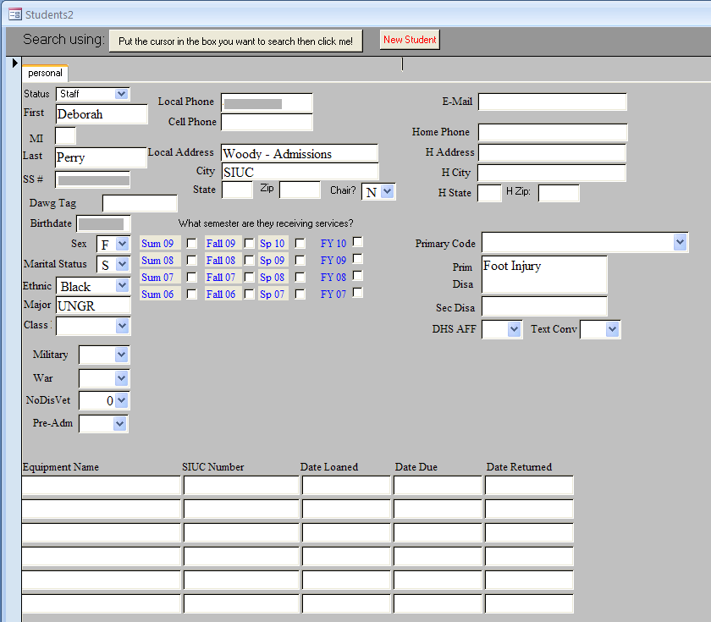
The Old System

Slide 7
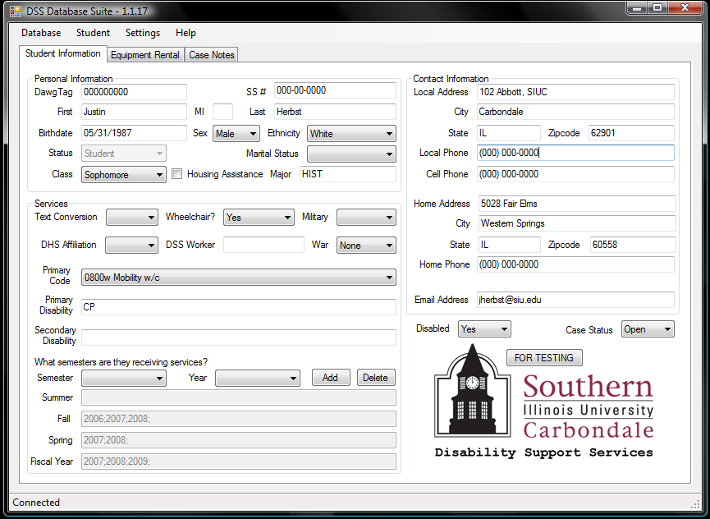
The New System

